Slide 1
The contribution of AI and Big Tech to Israel’s War Crimes
Dr. Daniele Fantin,
Earth Observation-Machine Learning Team Manager,
S&T Norway
Notes:
This presentation describes how technology, and AI in particular, is playing a crucial role in the crimes carried on by Israel in the Gaza military campaign, leading to a long list of violations of international law, including the crimes of genocide, crimes against humanity, and how the Big Tech have facilitated these violations.

Slide 2
Outline
How technology and AI are applied in war context
The Involvement of the Big Tech

Slide 3
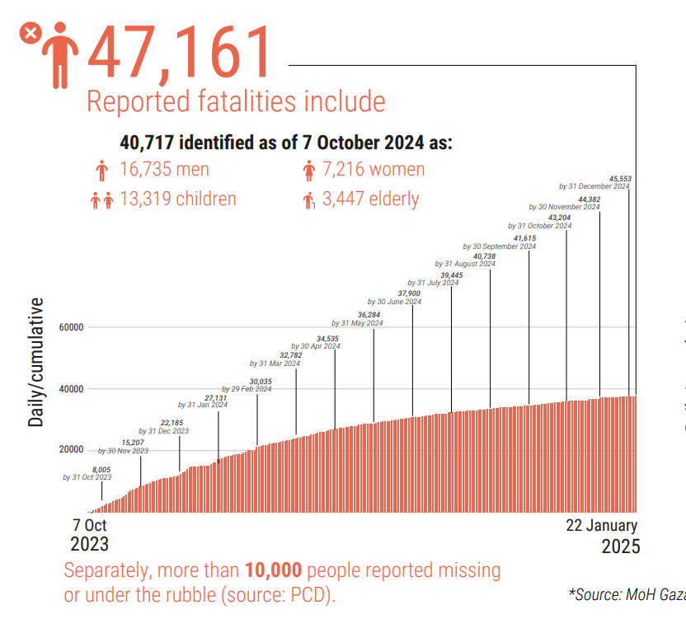
Huge Increase in amount of civilians killed and building bombed compared to previous military campaigns.

Slide 4
Technology & AI in War Context
Autonomous (or semi-) weapons
AI services and tools
Infrastructure (Cloud storage, computational power)
Influence Public Opinion
Notes:
LAWS have been condemned by the UN as “politically unacceptable and morally repugnant,” and there are growing calls for them to be banned.

Slide 5
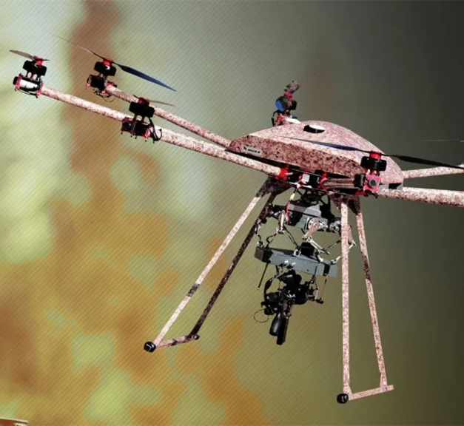
Weapons
Lethal autonomous (and semi-autonomous) weapon systems (LAWS).
Condemned by UN as “politically unacceptable and morally repugnant”.
Duke Robotics
Notes:
LAWS have been condemned by the UN as “politically unacceptable and morally repugnant,” and there are growing calls for them to be banned.

Slide 6
Glossary (Stay with me :o)
AI is a software that mimics cognitive human functions such as learning and problem-solving.
ML is the function of training software to recognize patterns in order to make predictions about future observations.

Slide 7
Glossary (Stay with me :o)
AI is a software that mimics cognitive human functions such as learning and problem-solving
ML is the function of training software to recognize patterns in order to make predictions about future observations.
Training a model is resource-intensive.
Part of Google’s appeal to customers is the option of using a pre-trained model.

Slide 8
Project Nimbus
$1.22 billion contract by AWS & Google with Israeli government (incl. military).
Unlimited cloud storage, computational resources, AI tools, including pre-trained models for:
  Facial detection
  Automated image categorization
  Object tracking
  Sentiment analysis
  Lie detection (?)
Notes:
Contract signed in 2021.
Machine learning is largely the function of training software to recognize patterns in order to make predictions about future observations
Clou

Slide 9
Project Nimbus
$1.22 billion contract by AWS & Google with Israeli government (incl. military).
Unlimited cloud storage, computational resources, AI tools, including pre-trained models for:
  Facial detection
  Automated image categorization
  Object tracking
  Sentiment analysis
  Lie detection (?)
Biometric Mass Surveillance
Collection of Data
Notes:
Contract signed in 2021.
Machine learning is largely the function of training software to recognize patterns in order to make predictions about future observations
Clou

Slide 10
Project Nimbus
$1.22 billion contract by AWS & Google with Israeli government (incl. military).
Unlimited cloud storage, computational resources, AI tools, including pre-trained models for:
  Facial detection
  Automated image categorization
  Object tracking
  Sentiment analysis
  Lie detection (?)
Applying AI ⇒ No limits!
Biometric Mass Surveillance
Collection of Data
Notes:
Contract signed in 2021.
Machine learning is largely the function of training software to recognize patterns in order to make predictions about future observations
Clou

Slide 11
The Human Bottleneck & The Gospel
“The Human bottleneck”: The generation and approval of potential targets is too slow because a lot of manual work is required.
The Gospel ⇒ AI tool used to generate infrastructure targets.

Slide 12
Lavender
Lavender (evolution of “The Gospel”) is an AI tool that identifies human targets using Israel’s surveillance data record.

Slide 13
Lavender
Lavender (evolution of “The Gospel”) is an AI tool that identifies human targets using Israel’s surveillance data record.
Which data? Biometric data, call records, locations, social network connections like WhatsApp contacts or Facebook friends and so on.

Slide 14
Lavender
Lavender (evolution of “The Gospel”) is an AI tool that identifies human targets using Israel’s surveillance data record.
What data? Biometric data, call records, locations, and social network connections like WhatsApp contacts or Facebook friends.
Increase in rate of targets from 50 a year to 100 a day!

Slide 15
Lavender: How does it Work?
Lavender uses this data to calculate a threat rating (being operatives in Hamas and palestinian Jihad), from 1 to 100, for each individual in the system.
Source: https://stopkiller.ai/

Slide 16
Lavender
Every phone call made, every friendship, and a visit to a shop can push the score up or down.
Source: https://stopkiller.ai/

Slide 17
Lavender
When a Palestinian's rating rises above a certain threshold, Lavender adds him to the kill list.
Source: https://stopkiller.ai/

Slide 18
Lavender
This is an example of social scoring, where individuals are categorized based on their social behavior or personal characteristics.
Source: https://stopkiller.ai/

Slide 19
Lavender
This kind of social scoring has been found to discriminate against marginalized communities ⇒ reduces individuals to data points ⇒ Dehumanization.
Source: https://stopkiller.ai/

Slide 20
Lavender
That’s why the European Union’s AI Act bans social scoring systems that work like Lavender.
Source: https://stopkiller.ai/

Slide 21
Lavender
The error rate of the system is at least 10%.
20 seconds for human check.
Only check made by a human was on the gender of the target.
Emergency responders, palestinian police etc can be easily “labelled” as targets.
The threshold was lowered when Israel ran out of targets to bomb.

Slide 22
Where is Daddy?
Surveilance system automatically linking targets to their homes.

Slide 23
Where is Daddy?
Where’s Daddy tracks every name in the kill list, monitoring their suspected location.

Slide 24
Where is Daddy?
When it suspects that are back home, a kill order is sent to the Israeli air force.

Slide 25
Where is Daddy?
At home, the target is often with their whole family.

Slide 26
Where is Daddy?
Several families may be living in the same apartment block.

Slide 27
Where is Daddy?
Israeli officers know that civilians are likely to be killed.

Slide 28
Where is Daddy?
They bomb them in their homes anyway.

Slide 29
Palestinian families and civilians are bombed in their homes because it is the easiest way to automate the killing machine.

Slide 30
Social Media (Meta: Facebook, Instagram, WhatsApp)
Fail in Content Moderation & prevent Algorithm Biases:
Disproportionate censorship of palestinian-related content.
Failure in tackling illegal and harmful content, including hate speech, incitement to commit war crimes, and state-sponsored disinformation.
Use of WhatsApp metadata as data source in Lavender
Notes:
For example, the social media accounts of Israeli officials, media, politicians, and the military remain active, even though they feature content that allegedly incites genocide against the Palestinian people.
Responding to allegations that WhatsApp data is used for the Lavender system, Meta publicly denied handing over people’s data to the Israeli government. While that may be true, there is no evidence to show that it has taken any concrete action to protect people’s privacy or to ensure that its metadata is not exploited to train and run dystopian AI systems.

Slide 31
The Big Tech Involvement
In name of profit, the Big Techs are providing the Israeli army with services and tools used to commit international crimes in Gaza.

Slide 32


Alphabet (Google, YouTube)
Provision of advanced AI tools as part of Project Nimbus.
Provision of cloud computing services.
Access to Google Photo for biometric surveillance.
Ads paid by Israel on YouTube and Google to shape public opinion.
Fired 50 employees who protested the company’s involvement in Project Nimbus.
Notes:
New contract signed with defence ministry in March 2024

Slide 33

Amazon Web Services (AWS)
AWS is Amazon’s cloud computing platform
Provision of cloud infrastructure as part of Project Nimbus.
Partner with Palantir to provide AI-powered military targeting tool to several actors including the Israeli military.
Used to store surveillance information on Gaza population.

Slide 34



Microsoft
Strategic partner of Israel’s military and security for 35 years:
Provision of AI expertises (including OpenAI).
Provides services used to support illegal settlement operations, the Israeli police and Prison Service.
Multiple arbitrary suspensions of emails and Skype accounts of Palestinians living abroad.

Slide 35
Take Home
Experimental, AI-based technology for automatization of military operations has been tested by Israel on Palestinians.
The Big Tech is colluded in the development of such technology.

