Slide 1
Testimonies from Gaza:
Technology and Genocide Through the Eyes of a Witness
Hani El Dada
UiO researcher

Slide 2
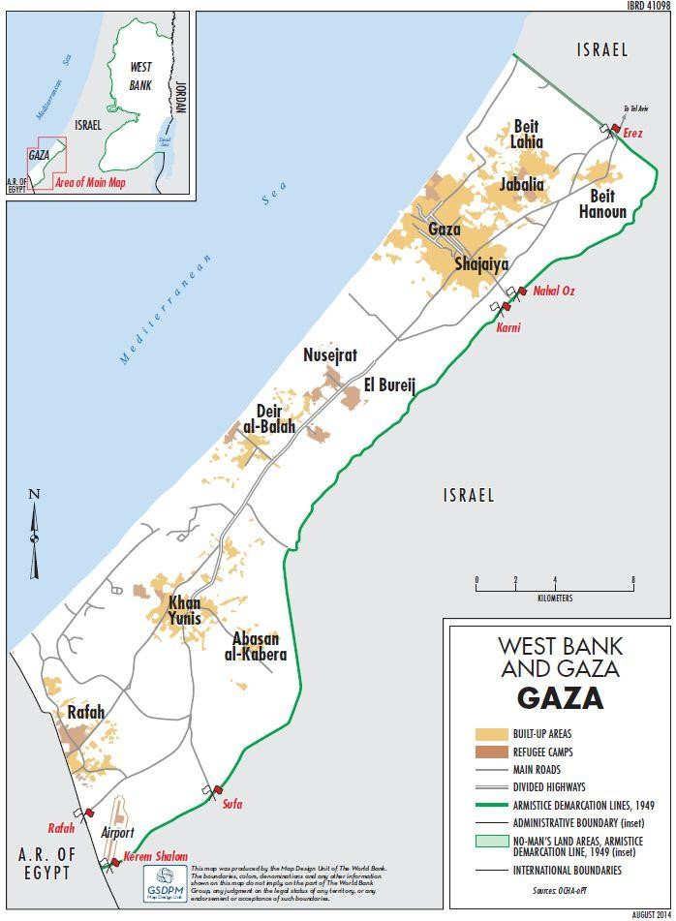
Gaza Strip: A Fact Brief
Area: 360 KM². Number of cities: 4 Refugee camps: 8 Population: 2.2 million. 66% of the Total Population in Gaza Strip are Refugees. Population density (2022): 6,024 people per square km. Poverty rate (2022) : 44.7%. 62% require food assistance. Unemployment level (2022): 46.6%. 78% of piped water in Gaza is unfit for human consumption. Source: Palestinian Central Bureau of Statistics (PCBS)

Slide 3
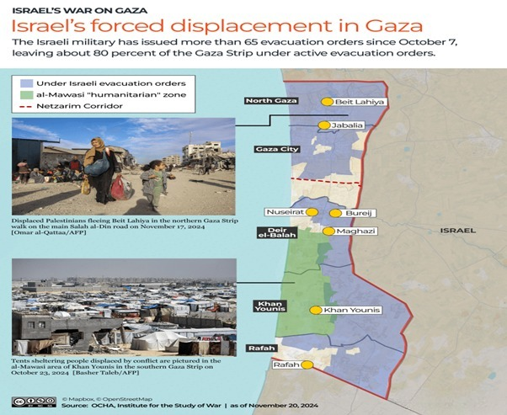
Displacement at the Start of the War: Israel Forces Most of the Population to Relocate to Central & Southern Gaza Strip
Israel's evacuation orders didn't make Gaza's people safer. Instead, they forced them to move and live in terrible conditions. There is no safe place for the people ordered to evacuate in Gaza to go.

Slide 4
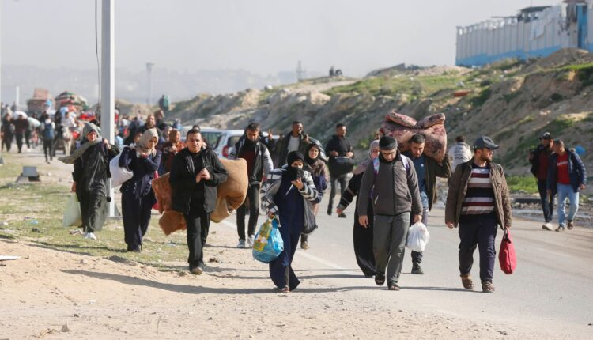
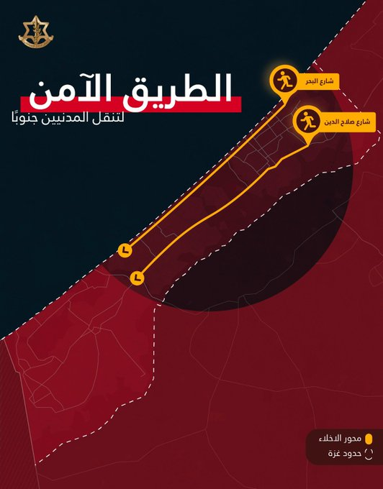
The Israeli army designates Salah Al-Din Road as a safe route for residents to move from northern Gaza to southern Gaza

Slide 5
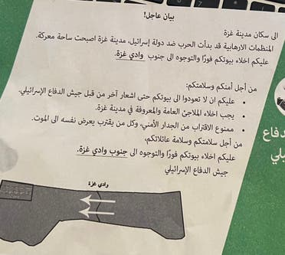
The Israeli army relies on drones to deliver instructions for evacuating areas in Gaza
Gaza City has become a battlefield... You must evacuate your homes immediately and move to southern Gaza for your safety and security. The army also included a drawing of a map of Gaza in the leaflet, with arrows pointing to the southern part of the Strip.

Slide 6
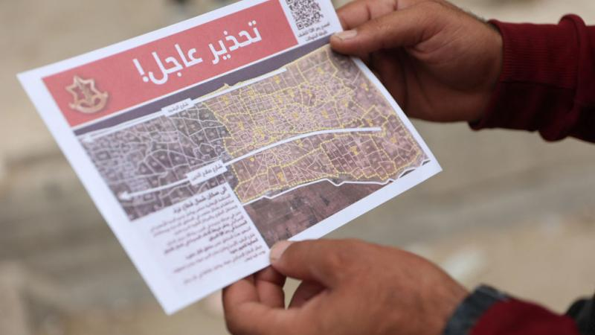
Urgent warning with explanatory maps from drones
Evacuating northern Gaza means relocating nearly half of the Gaza Strip's population to the already overcrowded southern area..

Slide 7
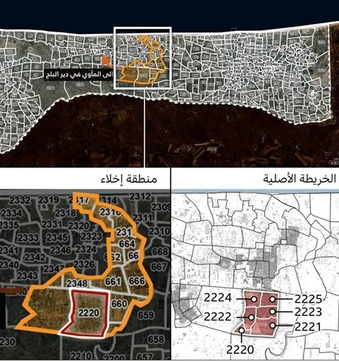
Social media posts maps identifying the areas designated for evacuation
Evacuation Zone The Original Map

Slide 8
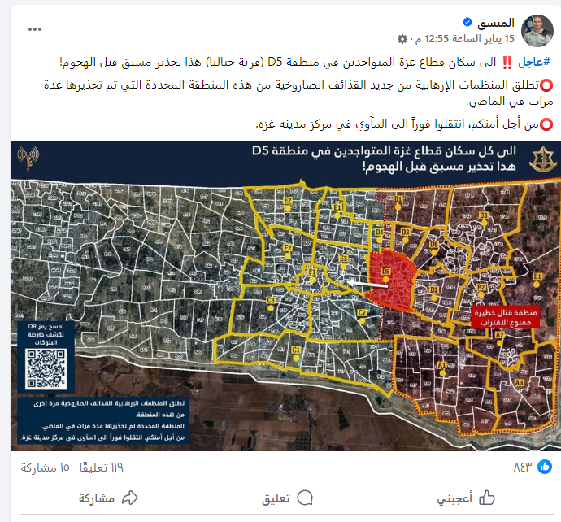
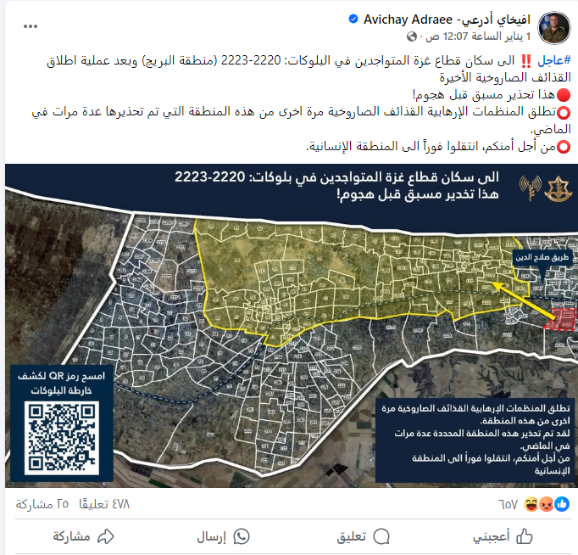
The page of the Coordinator and the spokesperson of the Israeli army for communication and issuing instructions
Coordinator of Israeli Government Activities Spokesperson of the Israeli army in Arabic

Slide 9
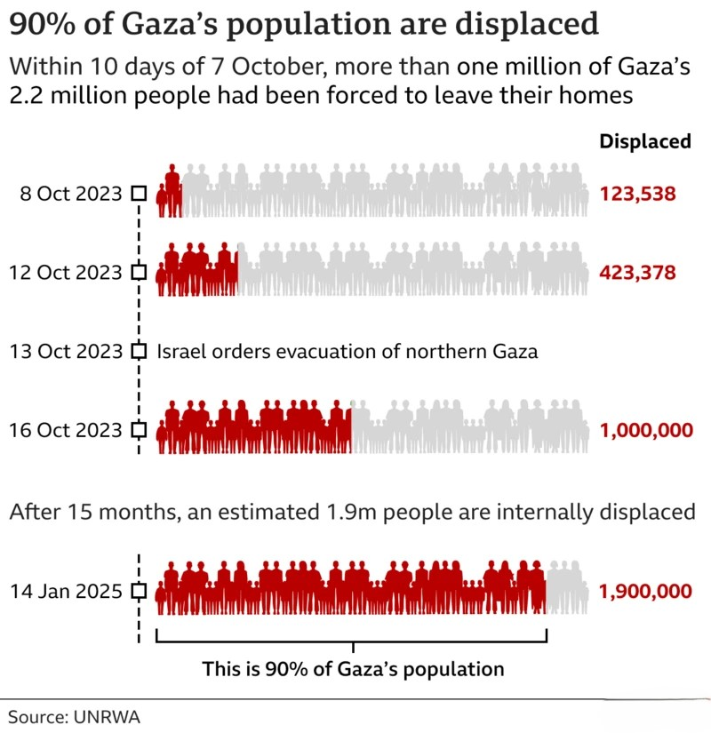
Continuous displacement & Search for survival

Slide 10
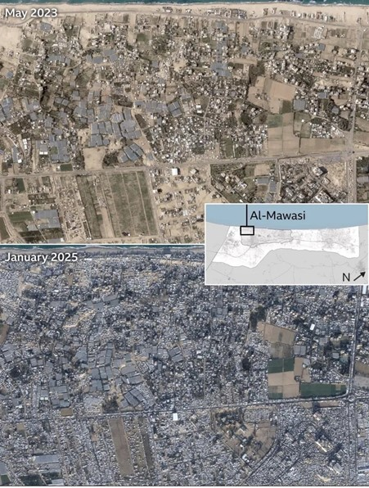
UNRWA stated that Israel has reduced the "humanitarian zone" to only 11% of the Gaza Strip's area

Slide 11
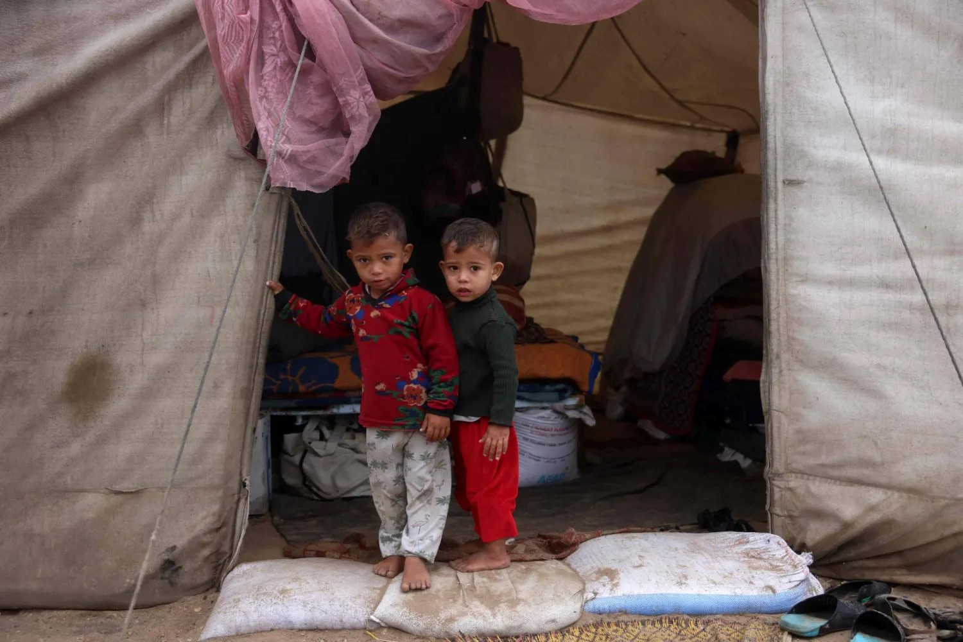
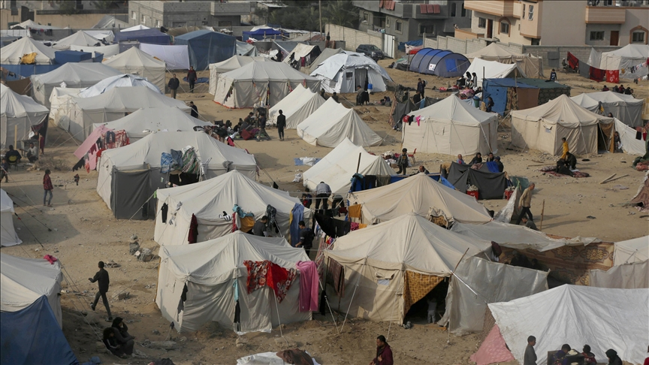
Displacement camps

Slide 12
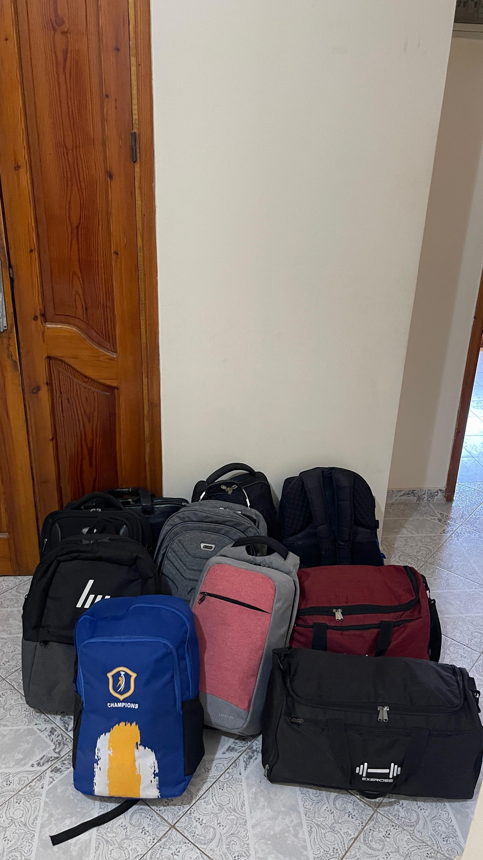
Just a few belongings my family & I managed to take when we were forced to leave our home

Slide 13
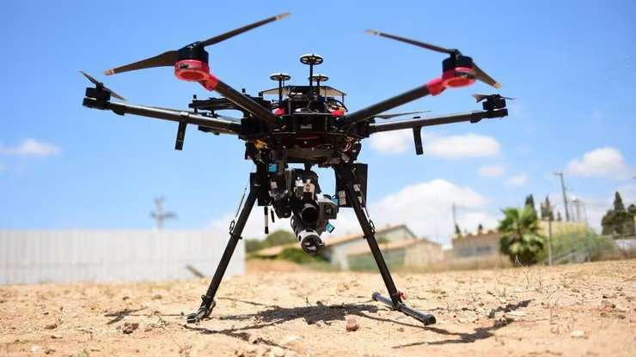
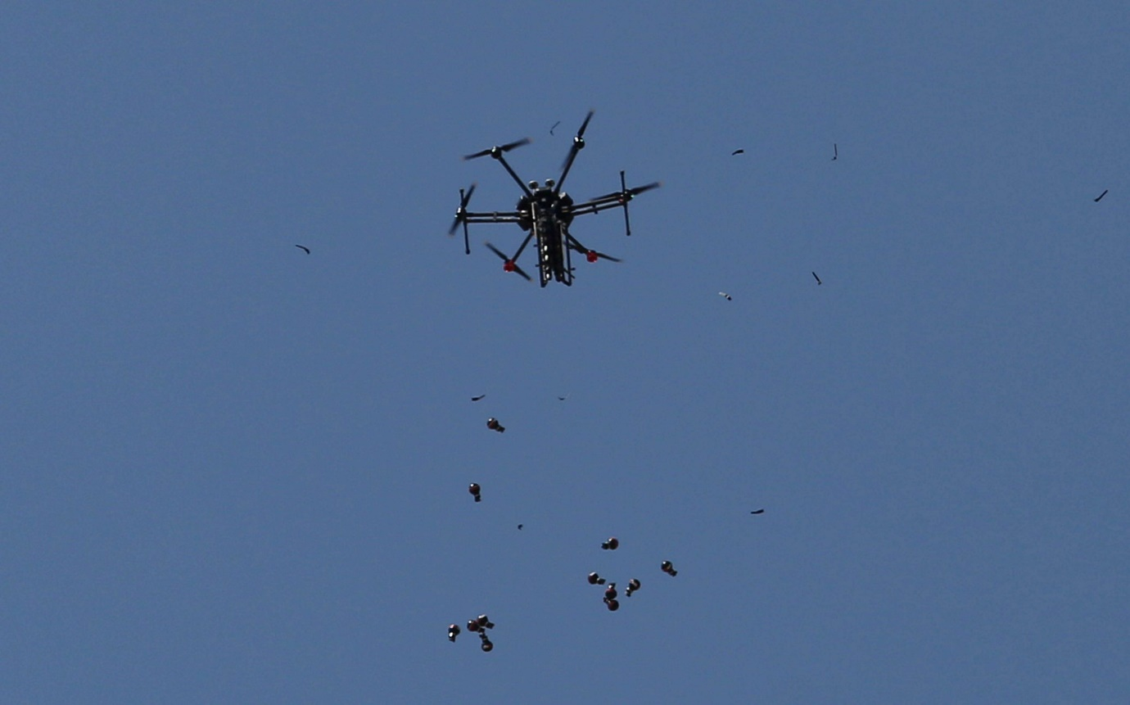
Drones are also used for dropping bombs

Slide 14
Drone Terror
Israel has used drones against Palestinians for over a decade, sometimes for surveillance and other times for strikes that result in amputations.
Since October 2023, the rate of killings committed by Israel against Palestinians has risen significantly, leading to Gaza being labeled as the "graveyard of children." Technology has played a major role in increasing the damage and targeting, including the use of drones & smart bombs.

Slide 15
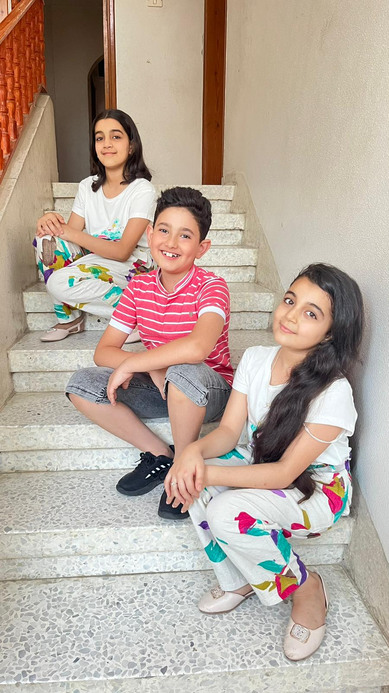
My Personal Experience with Suffering
The drone killed my brother
My brother Mohammad worked as a teacher at an UNRWA school and loved his family deeply. He had four daughters and one son. He was happy in his life, loved his job, and was loved by everyone. Mohammad had a hobby of taking care of canary birds, which was cherished by our entire family.

Slide 16
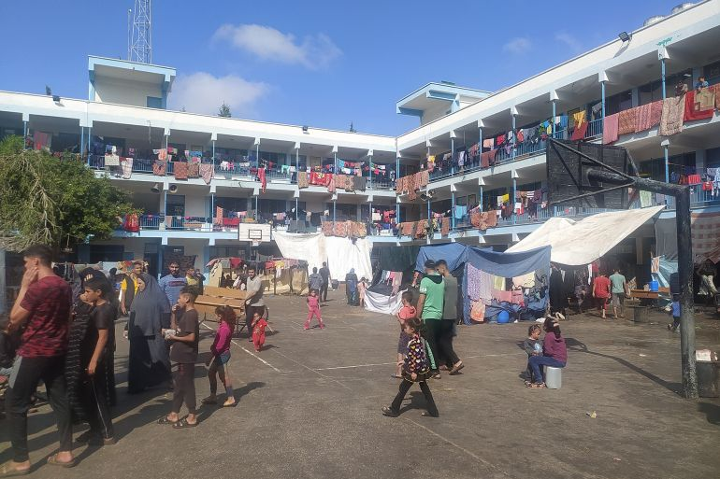
Mohammad volunteered at one of the UNRWA shelters to help others
In the summer of 2014, the war on Gaza began. Like many other families, we were forced to leave our home in Al-Zaytoon and move to another area within Gaza. Mohammad also had to leave his beautiful birds behind, which was very hard for him, he volunteered at one of the UNRWA shelters to help others.

Slide 17

Mohammad went to feed the canary birds, but a drone targeted him with a rocket
About a week later, Mohammad told me he wanted to go back to our house to feed the birds. On his way there, just a few meters from the house, an Israeli drone targeted him with a rocket. Mohammad was martyred that day, and his beautiful birds died with him. His loss left a wound in our hearts that will never heal.

Slide 18
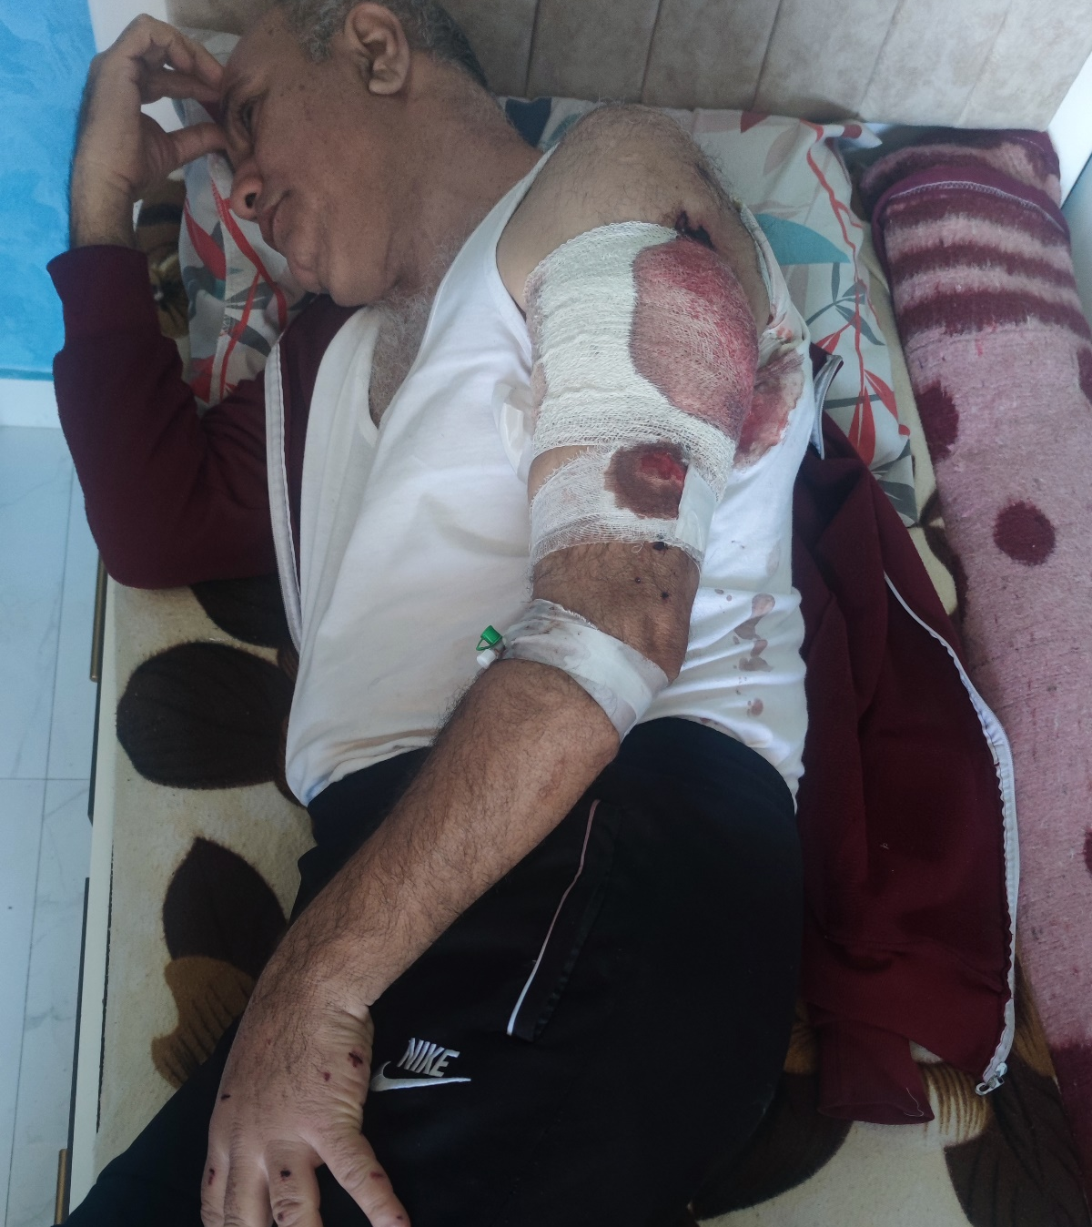
My survival from certain death

Slide 19
What happened exactly? This is the story!!!
On February 4, 2024, I went to the cemetery to attend the burial of a relative. Upon arrival, as soon as I got out of the car, a drone targeted the car with a rocket.
I was injured in my shoulder and thigh, and my body was filled with shrapnel. I was immediately taken to the hospital, where the shrapnel was removed.
After three hours, I returned home due to the lack of proper treatment at the hospital. I sought help from relatives and friends to secure the treatment I needed.
Am I a terrorist to be targeted?!!!

Slide 20
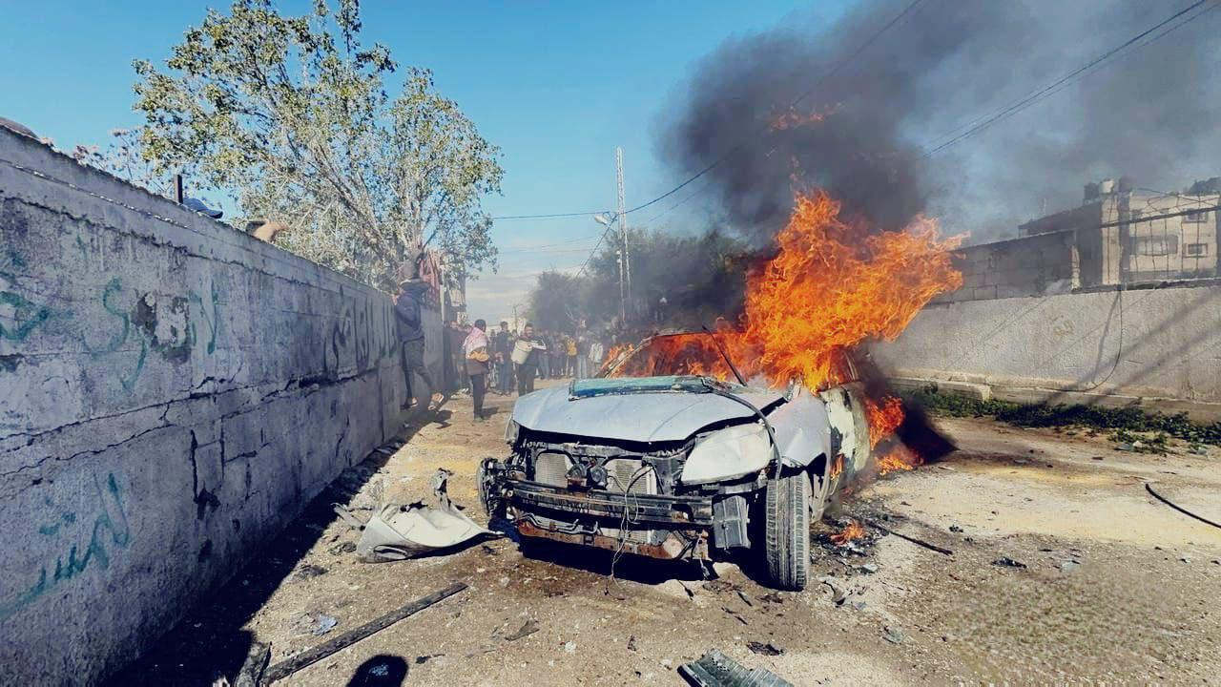
The Israeli army uses drones to kill innocent people
This is the car that was bombed after I got out of it

Slide 21

Everyone is targeted, including those working in the humanitarian field
7 WCK team members killed in Gaza.
The seven killed are from Australia, Poland, United Kingdom, a dual citizen of the U.S. and Canada, and Palestine.

Slide 22
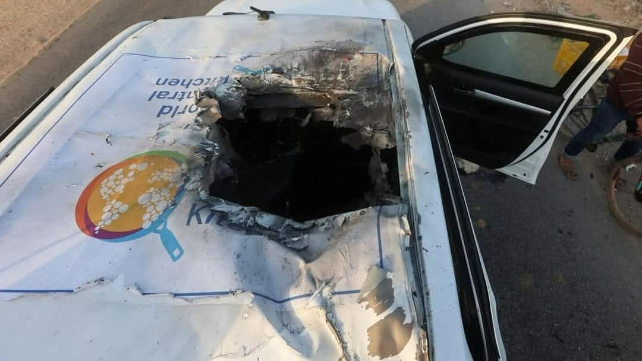
The World Kitchen staff use their own car with their logo
The drone was able clearly to see the car and the logo, but it targeted them with a missile.
Despite coordinating movements with the IDF, the convoy was hit as it was leaving the Deir al-Balah warehouse, where the team had unloaded more than 100 tons of humanitarian food aid brought to Gaza on the maritime route.

Slide 23
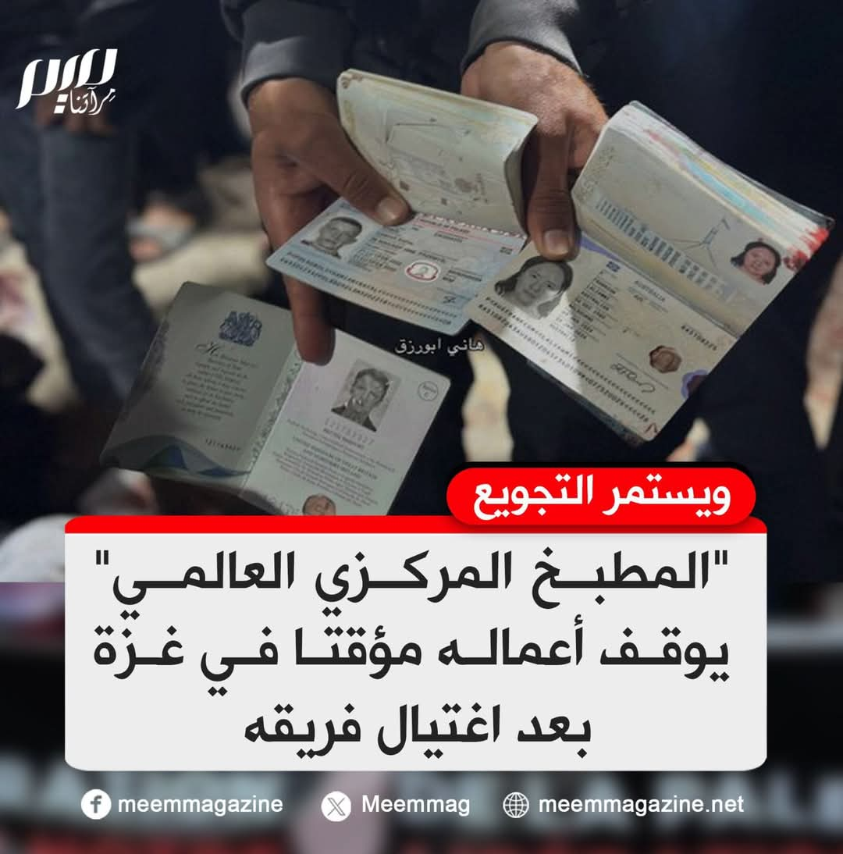
Deliberate killing and a systematic hunger policy
The World Central Kitchen suspends its operations in Gaza, and the starvation continues...

Slide 24
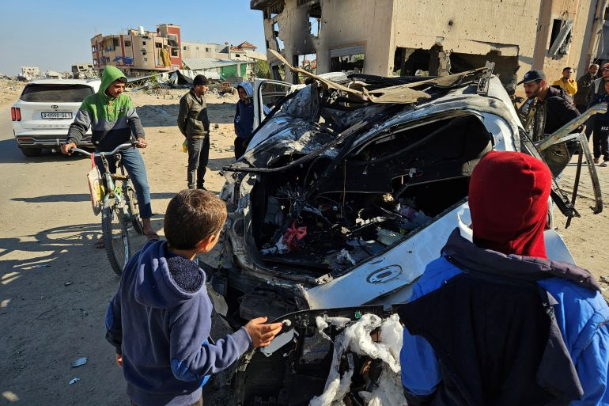
Drones continue to target and kill aid workers
Again, in November, drones kill three World Central Kitchen employees in Gaza.

Slide 25
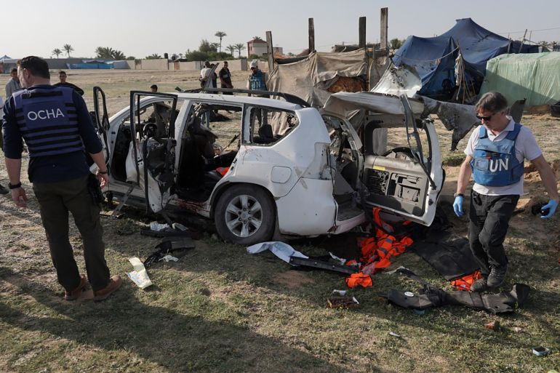
Targeting humanitarians?
Since October 7, 2023, at least 333 humanitarian workers in Gaza have been killed in Israeli attacks, according to the UN.
Most of them were targeted by drones and smart weapons.
On the evening of Thursday, August 29, 2024, a drone targeted a vehicle at the front of a humanitarian aid convoy carrying food and fuel to the UAE Red Crescent Hospital, resulting in the death of 4 Palestinians, who were members of a local protection team contracted with the intermediary company for ANERA.
Most of the humanitarian workers' missions were coordinated with the IDF, yet they were still targeted.

Slide 26
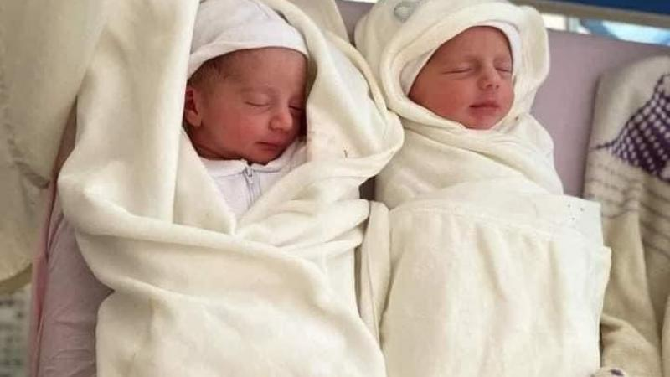
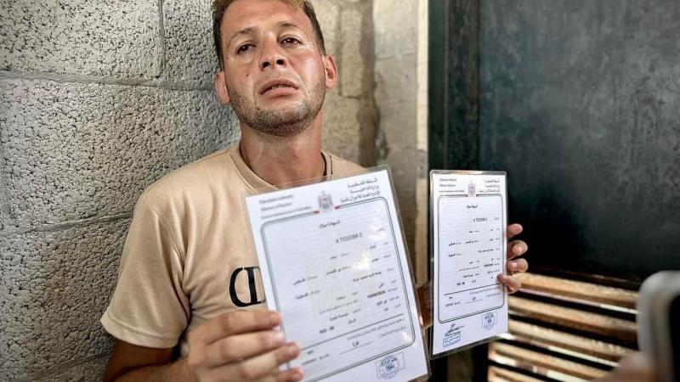
Even newborn babies were not safe from the bombs
Mohammed Abu Al-Qumsan is the father of the twin children, Asil and Asir, who were killed in an airstrike by a fighter jet carrying smart bombs.

Slide 27
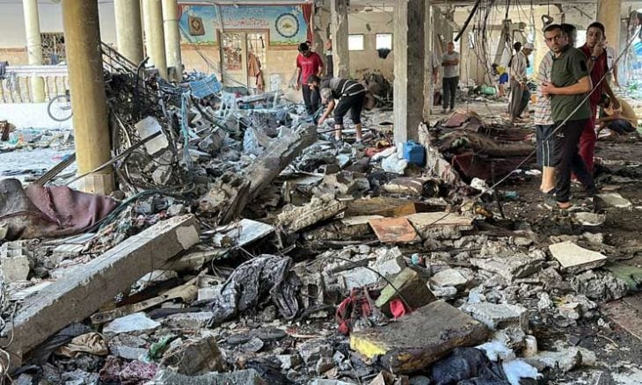
Made by Boeing.. Details of the American bomb that burned the Al-Tabeen School in Gaza
Following the "horrific massacre" committed by Israel at the Al-Tabeen School in the center of Gaza City, which resulted in the deaths of at least 93 people, details emerged about the weapon used on the school, which was sheltering Palestinian displaced people.
Weapon experts said that Israel used a GBU-39 precision-guided bomb, designed as a high-precision munition "intended to target strategically important objectives."
Shelters have become strategically important objectives !

Slide 28
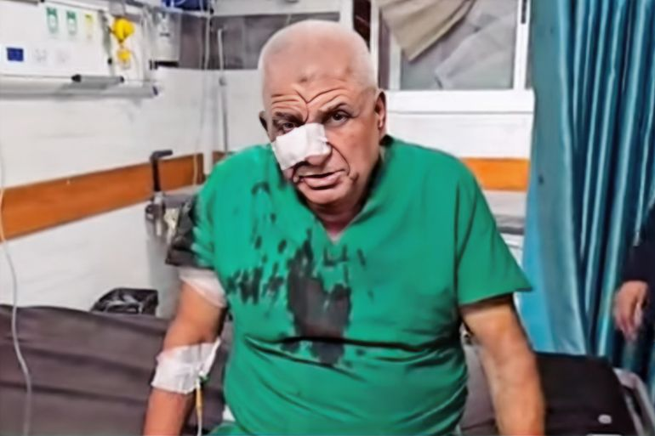
Doctors & "Angels of Mercy" in Gaza face the hell of drone strikes "Quadcopters."
Among the most famous victims of this drone, which targeted hundreds of Palestinians, was my friend Dr. Saeed Joudah, the only orthopedic doctor in northern Gaza. He was martyred on his way to the work at Al-Awda Hospital in the Jabalia refugee camp last December.

Slide 29

Adnan Al-Bursh the head of the orthopedic department at Al Shifa hospital
My friend Dr. Adnan He was injured during the war, then arrested, and died in prison due to torture.

Slide 30
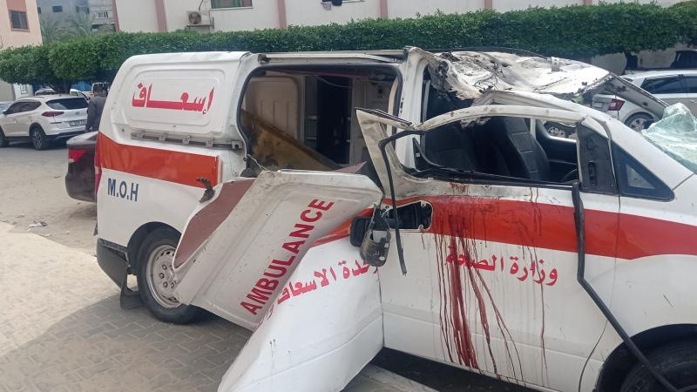
Medical & ambulance crews were not spared from drone strikes

Slide 31
"Quadcopter" drone
Used extensively to kill Palestinians
"Quadcopters" are small-sized drones used for various tasks such as surveillance, monitoring, and tracking fixed and moving targets. They can fire bullets and launching bombs toward targets and were used effectively during the war on Gaza.

Slide 32
Harsh experiences with the "Quadcopter" drone
Since many years, the people of Gaza suffer from the sounds of drones, known locally as "Zanana," which fly all the time at low altitudes, causing anxiety and insomnia due to their constant noise.
The people of Gaza consider the flight of drones in their skies an omen of doom, as it signals an impending attack. This feeling of fear has intensified during the war.
Whenever I heard its sound, I would try to hide from it, even though I am a civilian. However, this behavior became more frequent after I was injured in February.
Through the loudspeakers mounted on the drone, residents were asked to evacuate their homes, threatened with death. It would also emit terrifying sounds, resembling the noise of tanks or the screams of children.

Slide 33
Real experiences with the "Quadcopter" drone
“My cousin escaped from the death"
My cousin, Muneer, who lives in northern Gaza City, told me: I was forced to evacuate my home after a quadcopter drone arrived and ordered us to leave, threatening to bomb and kill us if we didn’t comply. The drone began firing at my house, so I fled with my family and took refuge in my brother's nearby house. We spent our night there, couldn’t sleep because of the fear and terror. In the morning, we moved to a shelter at one of the UNRWA schools, carrying a white flag, my wife and my daughter's children were in a state of extreme panic, but we miraculously survived.

Slide 34
Continues suffering with dammed "Quadcopter"
“My friend was injured"
My friend Ali, who lives in Al-Zaytoun area south of Gaza City, was forced to evacuate his home along with his siblings three weeks after the war began, except for his eldest brother, who refused to leave. About a month later, the house was bombed and destroyed. When Ali and one of his brothers went to check on their eldest brother and the house, a drone began shooting at them. Ali was injured and taken to the nearby Al-Ahli Baptist Hospital, where the bullet lodged in his shoulder was removed. By the grace of God, he survived.

Slide 35
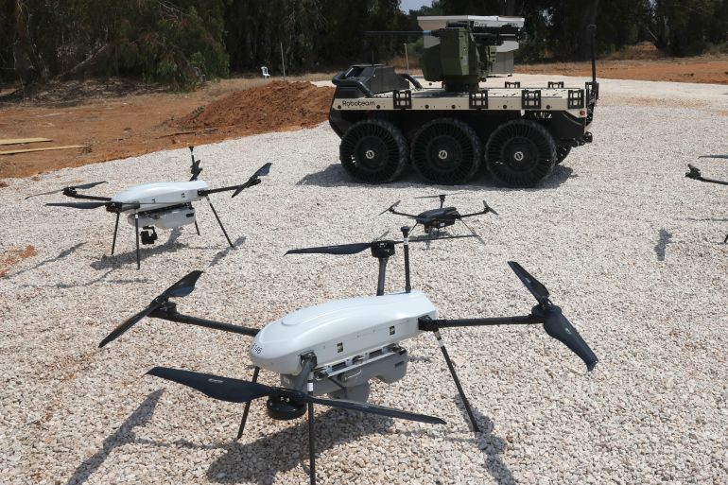
New technology: Robots carrying tons of explosives destroy both humans and structures in Gaza

Slide 36
One robot destroys several houses at once
After the Israeli army used to ask residents to evacuate their homes, it adopted a new method as part of its plan to displace and exterminate the population: remotely operated robots to destroy residential buildings, many of which are often inhabited.
Al Jazeera's correspondent in Gaza, Anas Al-Sharif, reported that what is happening in Jabalia camp is not a military operation but the largest act of ethnic cleansing in modern history.
A relative told me that when he went to check on his house in Rafah, he was shocked by the horrific scene. He couldn’t even identify where his home used to be, as the entire area was destroyed, likely due to the tons of explosives carried by the robots.

Slide 37
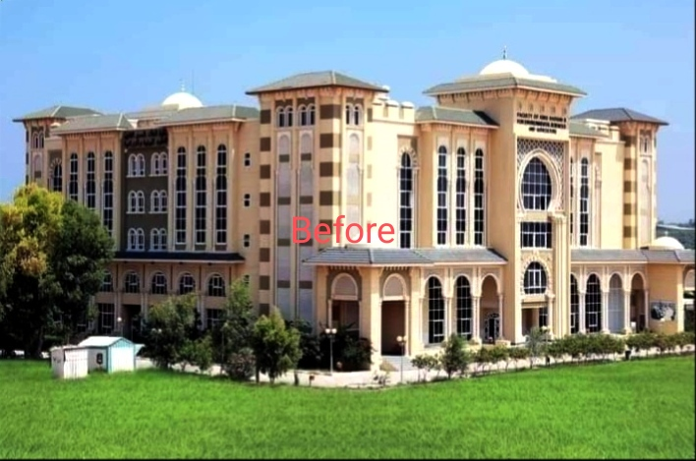
Destruction of schools & universities
Al-Azhar University before the war

Slide 38
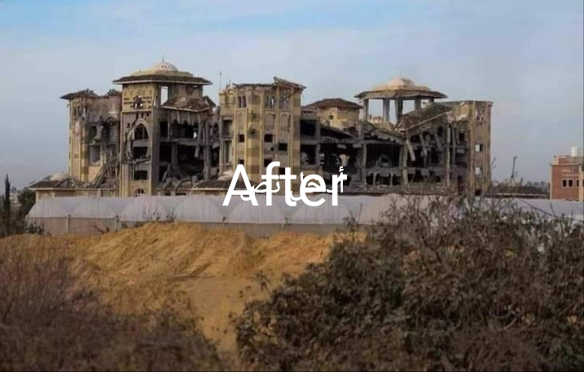
Al-Azhar University after the war

Slide 39
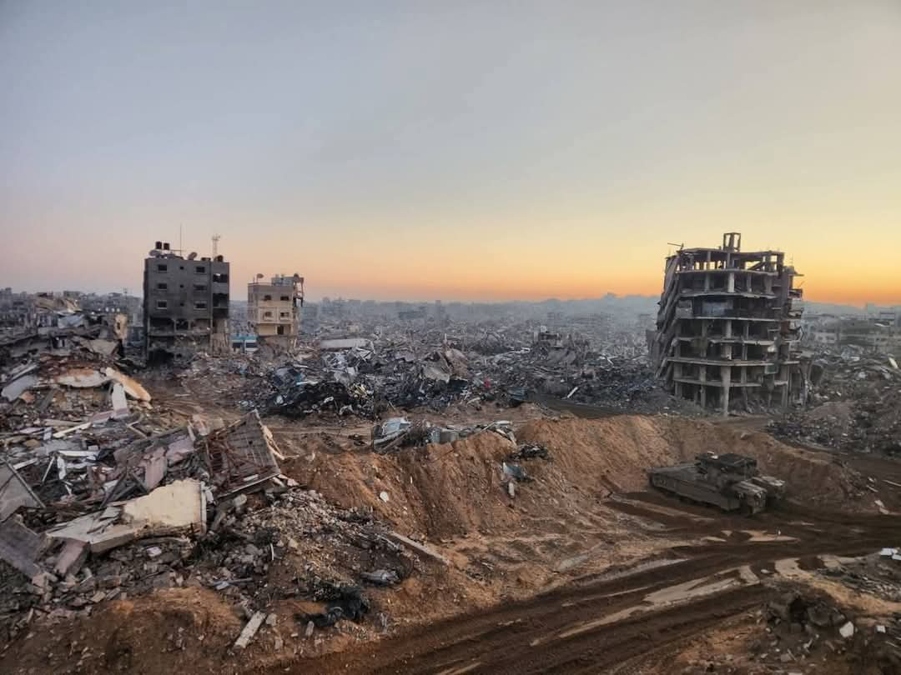
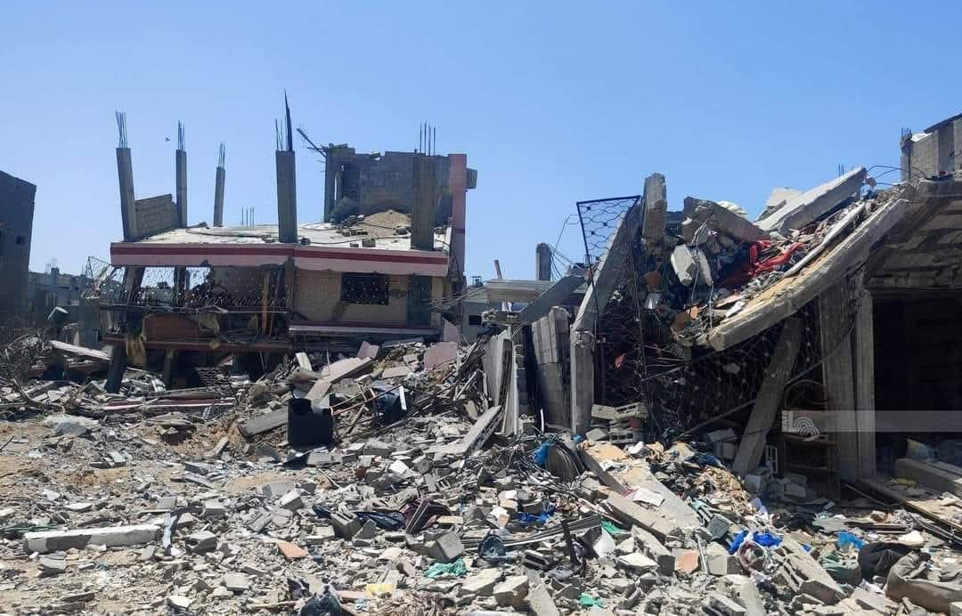
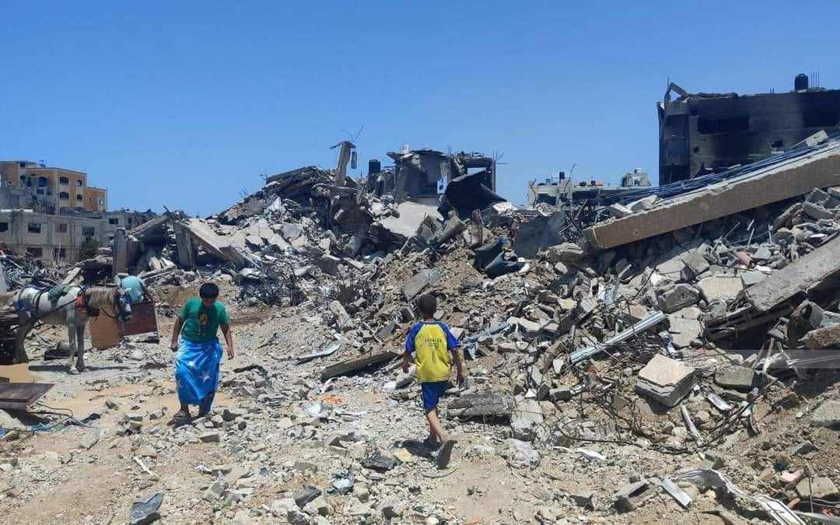
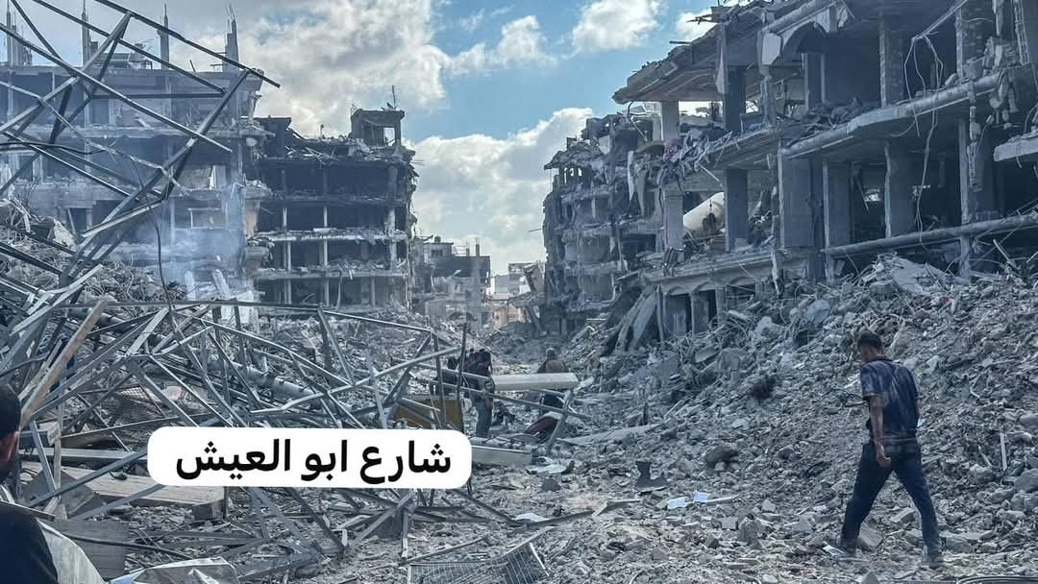
Life is not like life in Gaza after the war
People are unable to identify the location of their homes

Slide 40
Thank you
Hani Eldada

